Slide 1
Week 21-22
ICCV2023

Slide 2
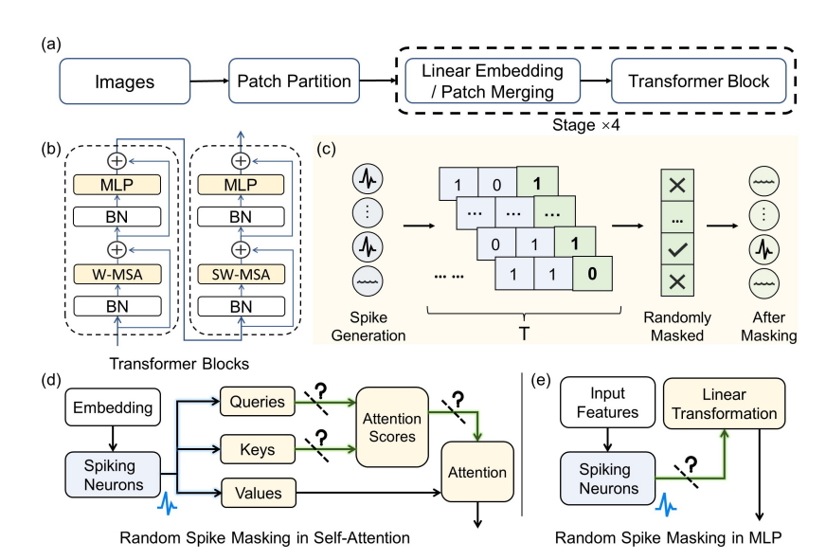
Masked Spiking Transformer

Slide 3
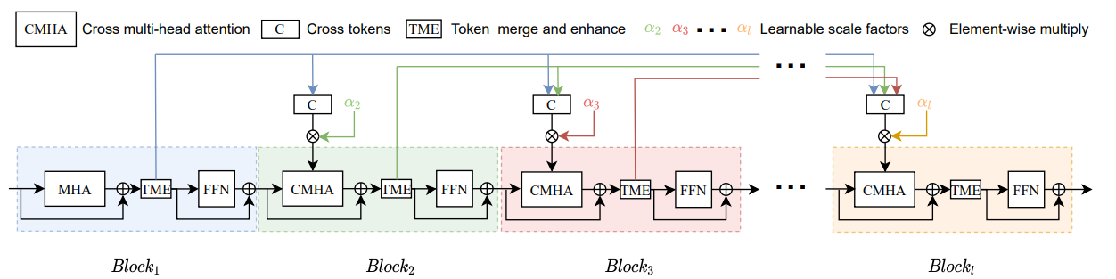
Fcaformer: Forward Cross Attention in Hybrid Vision Transformer
Dense Connect and Learnable Scale Factors
Token Merge and Enhance

Slide 4
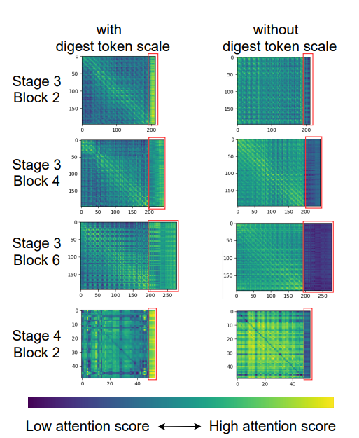
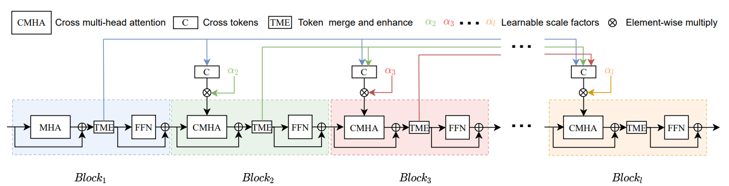
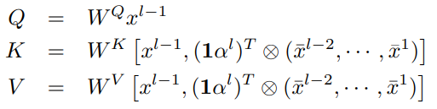
Dense Connect and Learnable Scale Factors
Like DenseNet, Facformer make dense connection in each stage.

Slide 5
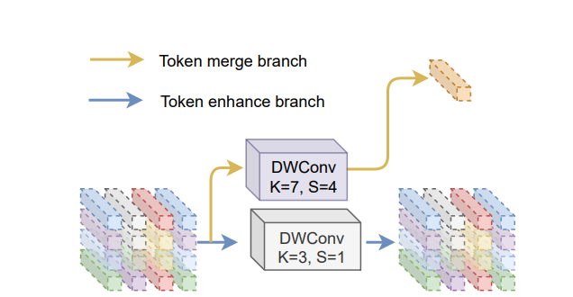
Token Merge and Enhance

Slide 6
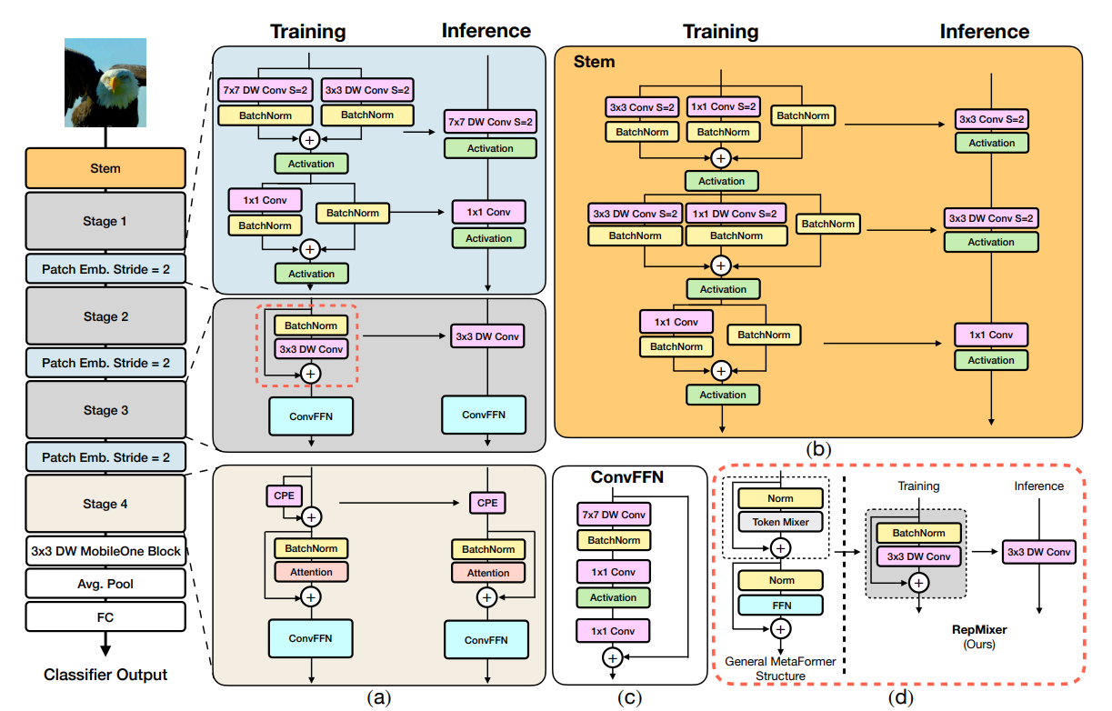
FastViT: A Fast Hybrid Vision Transformer using Structural Reparameterization

Slide 7
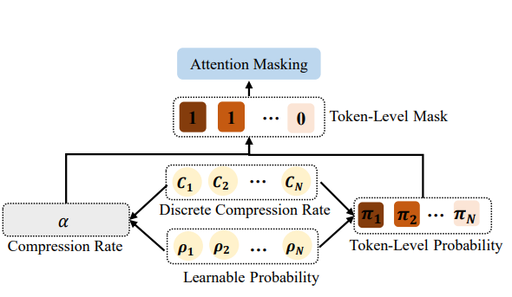
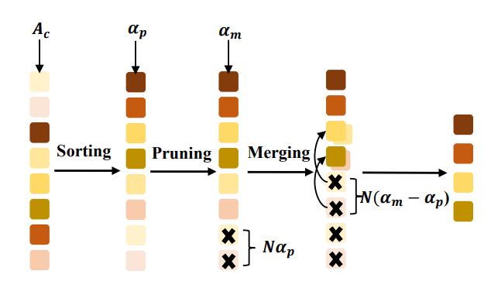
Differentiable Compression Rate for Efficient Vision Transformers

Slide 8
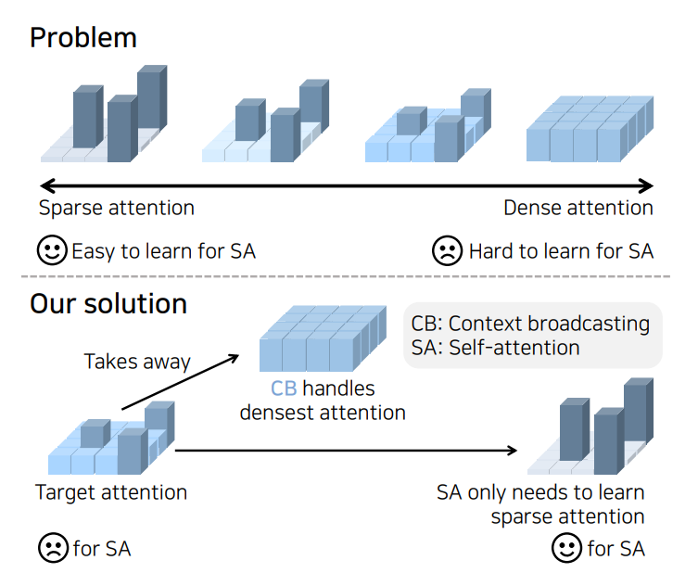
Scratching Visual Transformer’s Back with Uniform Attention
Difficult learning in Self-Attention
Broadcasting Context

Slide 9
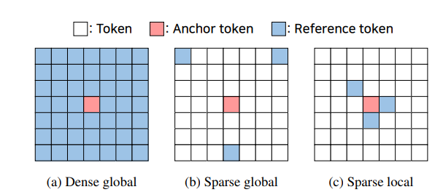
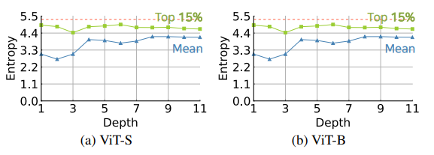
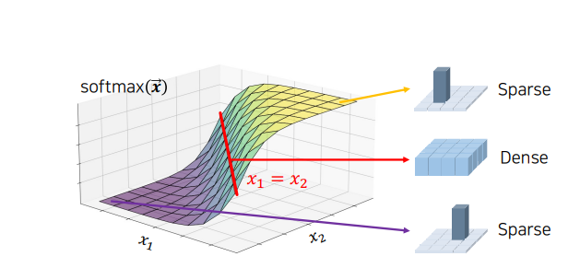
Difficult learning in Self-Attention

Slide 10
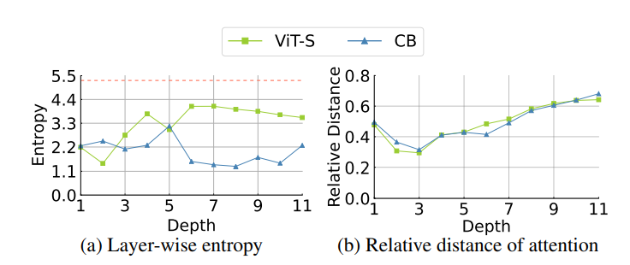
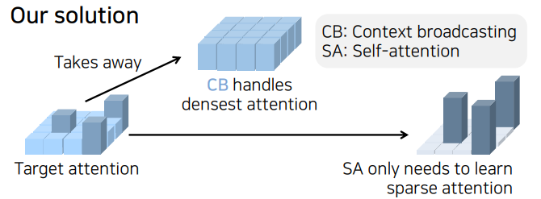
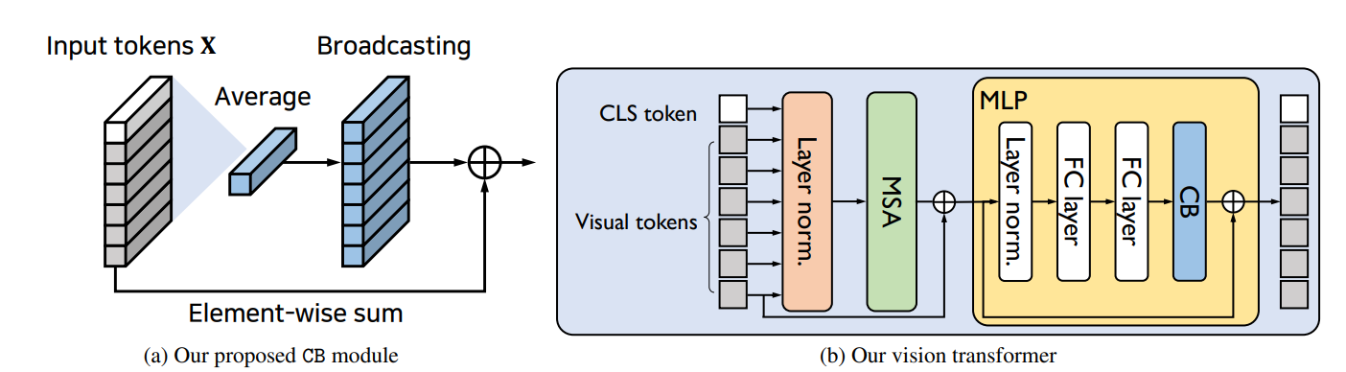
Broadcasting Context

Slide 11
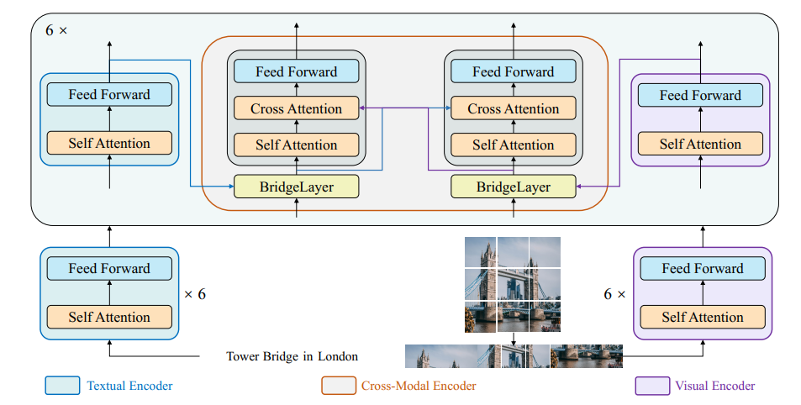

BridgeTower: Building Bridges between Encoders in Vision-Language Representation Learning (AAAI 23)
K,V
Q

Slide 12
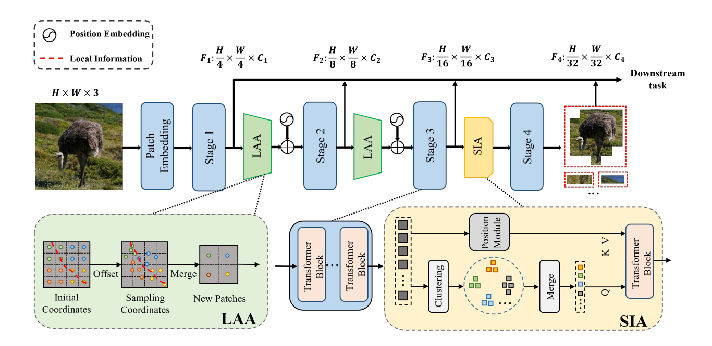
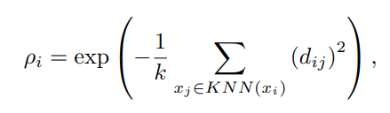


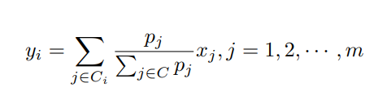
Building Vision Transformers with Hierarchy Aware Feature Aggregation

Slide 13
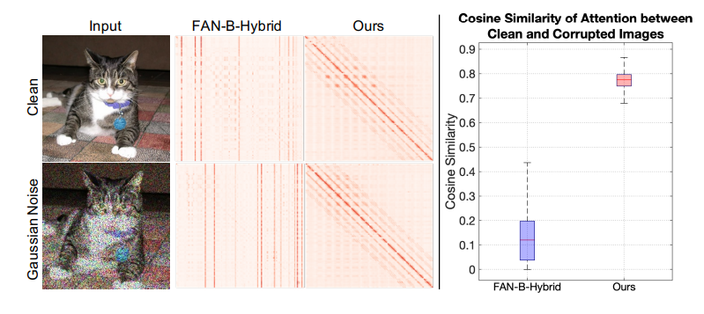
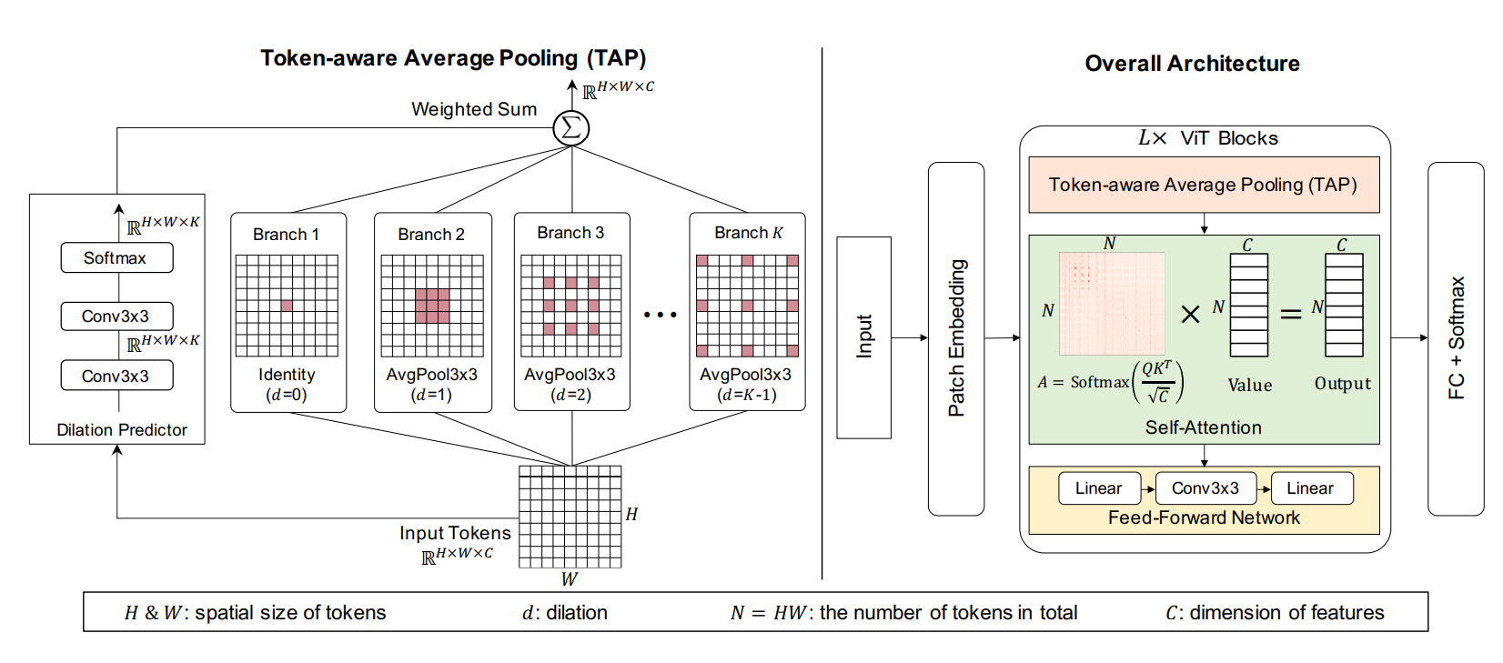

Robustifying Token Attention for Vision Transformers
$$\sum{α×x}$$

Slide 14
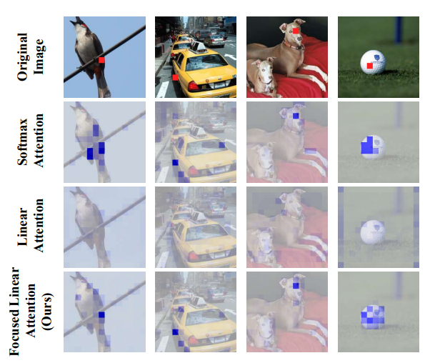
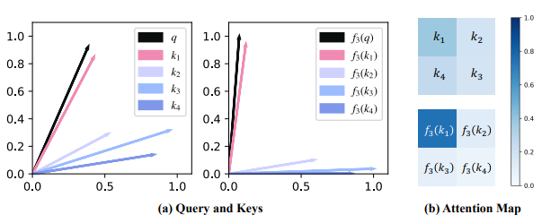
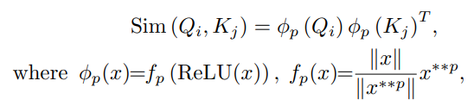
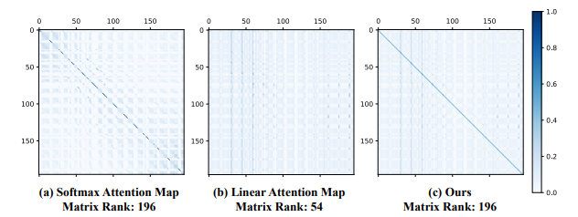
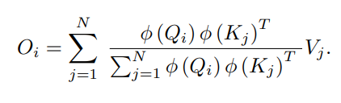

FLatten Transformer: Vision Transformer using Focused Linear Attention

Slide 15
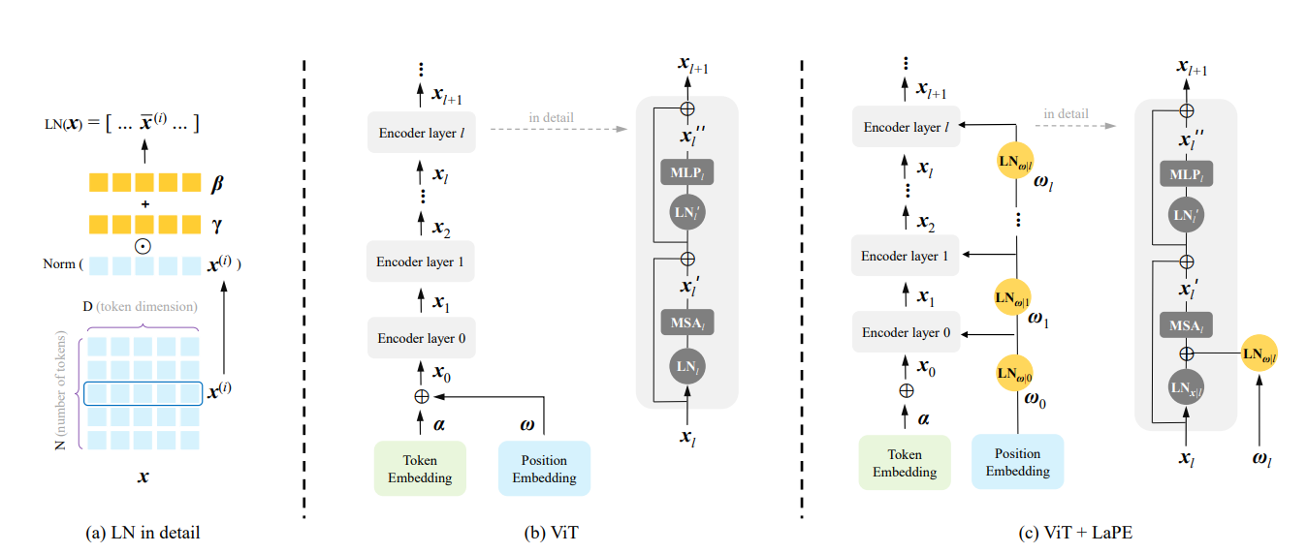
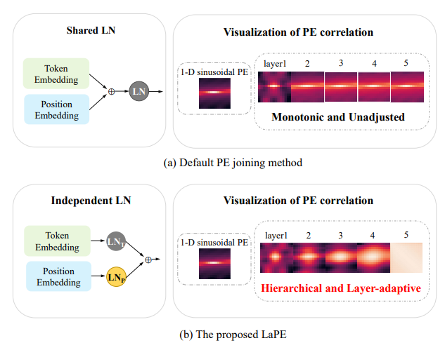
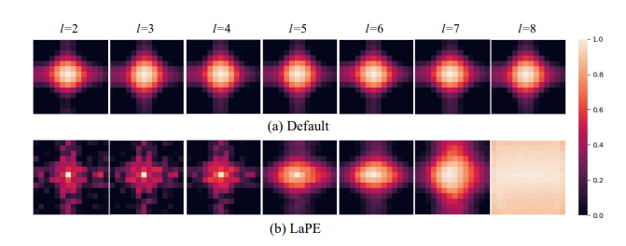
LaPE: Layer-adaptive Position Embedding for Vision Transformers with Independent Layer Normalization

Slide 16
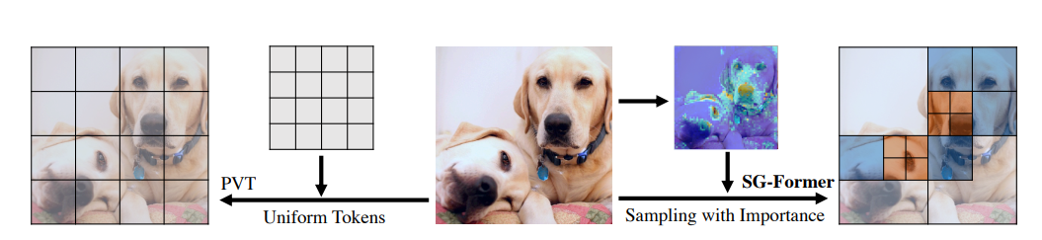
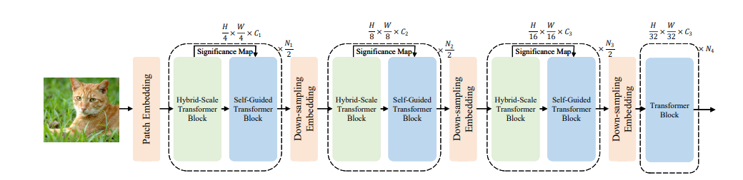
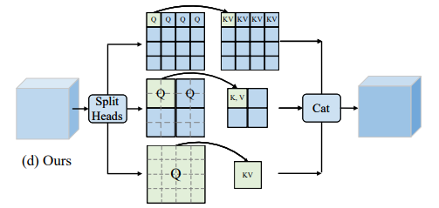
SG-Former: Self-guided Transformer with Evolving Token Reallocation

Slide 17
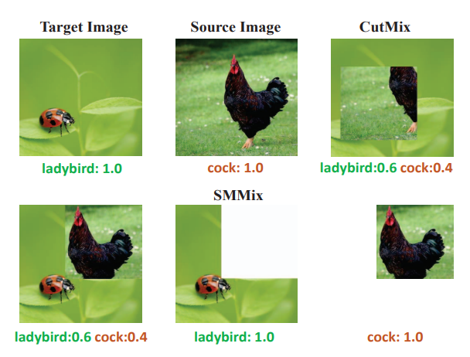
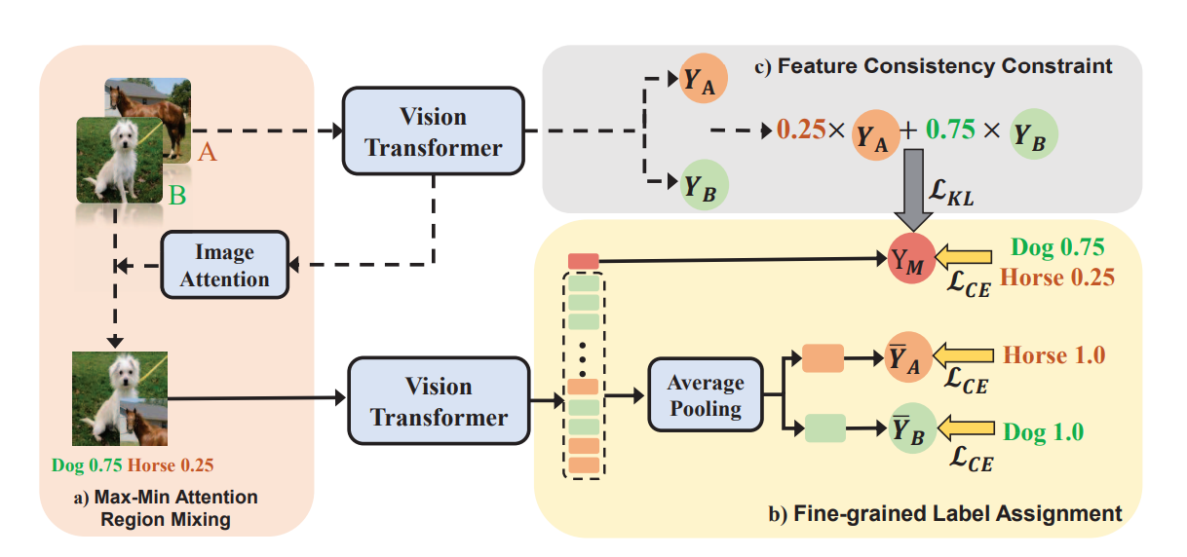
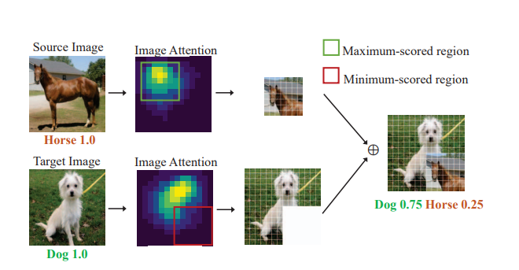
SMMix: Self-Motivated Image Mixing for Vision Transformers

Slide 18
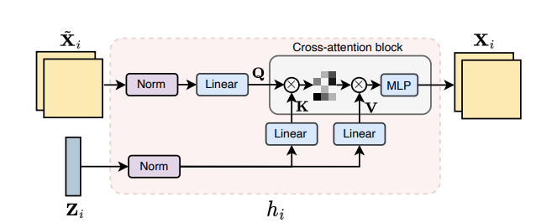
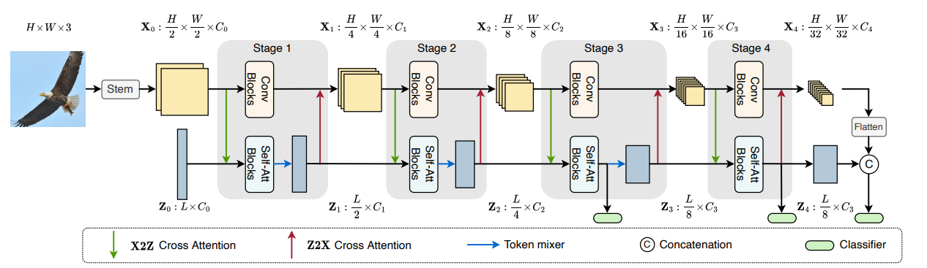
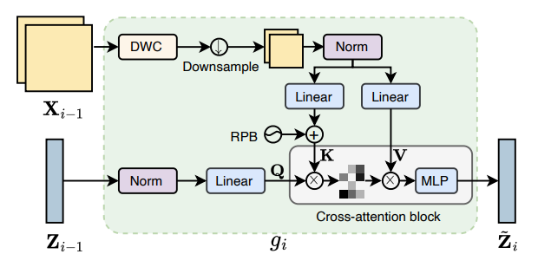
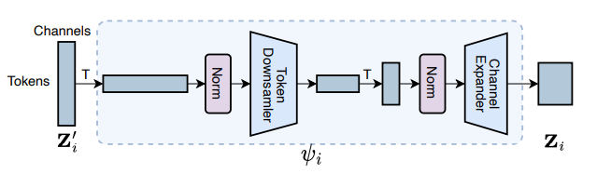
Dynamic Perceiver for Efficient Visual Recognition

